Slide 1


Slide 2
CURRENT SITUATION
According to the findings of a survey by the institute for business value and oxford economics ,80% of India’s startups fail within the first 5 years.
Which clearly shows mismatch between the startups and the advertising done to them.
In spite of having good idea a bad marketing skill or lack in advertisement makes them miserably fail

Slide 3
Business Plan : An Advertising agency-Dealers
To act as a hub or a platform for different companies for advertisement of their product or firms .
We tie up with different magazines publishers ,local newspaper distributors ,printing press or distributors which indirectly helps in the overall growth of a company.
We also have team of creative and brilliant minds who design posters and banners with eye catching designs and content which gives human attention.
We do digital marketing of products, Google Ads ,You Tube Ads.
,Search Engine Optimization

Slide 4

Importance of Advertising Agency
Fresh and Unique perspective
Cost-effective
In-House Effective
Value of Time
New Set of Connections
Creative Art
Financial Management
Creation and Execution

Slide 5

What makes us different ?
1.Multilingual Advertising
2.Event Sponsor Organizer
3.Social Media Handler ( Mainly Focus on Youth )
4.Set Up of Cross connections between clients.
5.Caring of shelf-offtake of product
6.Managing the Launch of a new product in the market
7.Coined the baseline of product
8.Campaign in schools, villages about how useful the product is.
9.Data Driven Marketing
10.Value for money advertising

Slide 6
Our Aspect
1.Digital Marketing Manager
-Google ads, YouTube ads
-Pay Per Click ads
-Search Engine Optimization
2.Traditional Marketing Manager
-Flex, Banners, Posters
-Newspaper ads, Magazine ads
-Television ads, Radio advertisement
3. Marketing and Finance Manger
-Marketing of ROI
-Finance Management
4. Data handling Manager
-Database of All The Clients
-Current scenario of All Present Companies in zone
5. Managing and feedback Managerhhhhhhhhhhhhhhhhhhhhv

Slide 7
We Market Our Services to:
Banks, Insurance Companies and other related Financial Institution
Corporate Organizations
Manufacturers and Distributors
Real Estate Owners, Developers, and Contractors
Research and Development Companies
The Government (Public Sector)
Schools (High Schools, Colleges and Universities) and Hotels
Celebrities, Politicians, Public Figures and Public Speakers
Sport Organizations, Religious Organizations
Political Parties
Television Stations
Printing Press (Publishing Houses) and Authors
Branding and Advertising agencies
Entrepreneurs and Start – Ups

Slide 8
Sales And Marketing Strategy
Introduce digital marketing agency by sending introductory letters alongside our brochure to individuals, corporate organizations, government agencies, non – profits, religious organizations and key stake holders.
Promptness in bidding for digital marketing contracts from the government and other cooperate organizations
Advertise our business in relevant business magazines, newspapers, TV stations, and radio station.
List our business on yellow pages ads (local directories)
Attend relevant international and local expos, seminars, and business fairs et al
Create different packages for different category of clients in order to work with their budgets and still deliver excellent design and services
Leverage on the internet to promote our business
Engage direct marketing approach
Encourage word of mouth marketing from loyal and satisfied clients

Slide 9
Publicity and Advertising Strategy
Place adverts on both print (newspapers and magazines) and electronic media platforms
Sponsor relevant community based events / programs
Leverage on the internet and social media platforms like; Instagram, Facebook , twitter, YouTube, Google + et al to promote our services
Install our Bill Boards on strategic locations all around.
Engage in road show from time to time in targeted neighborhoods
Distribute our fliers and handbills in target area.
Contact corporate organizations, non – profits and government agencies .
List digital marketing agency in local directories / yellow pages
Advertise our digital marketing agency in our official website and employ strategies that will help us pull traffic to the site.
Ensure that all our staff members wear our branded shirts and all our vehicles are well branded with our company logo at all.

Slide 10
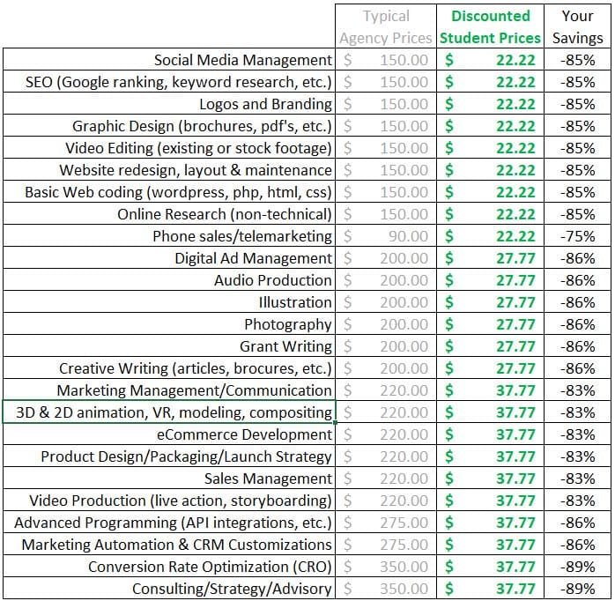
Revenue Model:

Slide 11
The Challenges we face
Irregular cash flow is one of the biggest problems agencies face, because they are not continually pitching new clients.
Owner of companies may find it difficult to trust us as the marketing of any product is the most important for any firms.
Marketing ROI is hard to measure.
One biggest challenge an advertising agency has to face if the client has NO established brand/name.
Getting more done with less.

Slide 12
Our team:
Anurag Sharma: Relation and contract manager, Finance manager
Gourav Majee: Chief Editor, Web and App Developer
Yash Khandelwal: Content writer, Digital Market Manager

